Slide 1
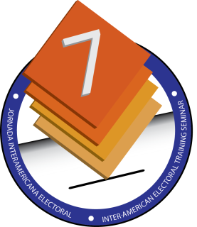
Encouraging people
with disabilities
to vote
Mr. Arunkoemar Hardien
Member Management Team Elections 2015 -
Suriname

Slide 2
Elections in Suriname –
brief overview
National Assembly and sub-national (local) elections in Suriname are planned for May 2015, followed by indirect elections for the President of the Republic. Elections are held every five years according to the electoral law.
Suriname has a mixed model of electoral management, with a dual structure: the Ministry of Home Affairs (hereafter the “MoHA”) is entrusted with the conduct of elections while the separate permanent body, the Independent Electoral Council (hereafter the “OKB”), is responsible for observing both pre-election activities (such as voter registration and distribution of voter cards), and validating the results.
In terms of organization of the elections, Suriname has been organizing and conducting their elections themselves, with limited international support.

Slide 3
Overview (cont’)
Suriname is one of the least densely populated countries in South America. The majority of the population lives in the coastal areas of the country. According to the 2012 census, the total population is 541,638, of which 66.3 percent lives in the capital Paramaribo and the neighbouring district of Wanica.
The remaining population is spread over the other eight districts. The district of Sipaliwini is the largest (79.7 percent of the land area), but also the most sparsely populated (only 7.3 percent of the population).
Voter turnout is relatively high in Suriname. In the 2010 elections, out of the 324,490 people registered to vote, 73 percent voted (237,575) Nevertheless, there seems to be significant barriers to people of the interior, who are mostly indigenous Amerindian peoples and Maroon tribes. Inhabitants from the interior face significant challenges in terms of access to the electoral process. Many of these groups do not speak Dutch or are illiterate creating difficulties for accessing voter information on voter lists, voter ID and voting procedures. Moreover, long distances and challenging travel logistics added to the challenges and expense of those populations checking and correcting problems related to voter registration.

Slide 4
Challenges
No specialized unit or department within the Ministry with the focus on electoral accessibility.
The physical conditions of the polling stations which are mostly situated in public school. These schools are not equipped with the proper facilities for persons with disabilities
Another challenge is the access to/entrance the polling booth for wheelchairs the height of the desk etc.

Slide 5
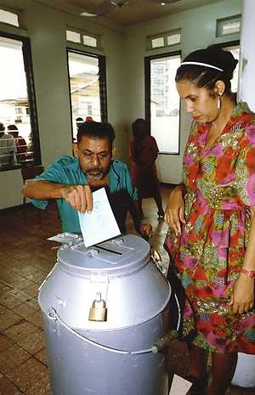
Challenges (cont’)
no mechanism within our Ministry/Government to identify and locate people with disabilities.
Present situation with regard to disabbilities:
Currently the electoral law permits the chair of the polling station to allow a voter to be assisted if he or she is incapacitated and unable to vote independently.

Slide 6
Plans and ideas for improvement
plans for the 2015 general elections specifically aimed at improving the conditions of accessibility at the polling stations in order to enable people with disabilities to fully exercise their electoral right.
Also the are civic education and awareness programmes already being developed by the Public Awareness and education Commission. This is also being done in different languages.

Slide 7
Plans and Ideas (cont)
Identification of effective mechanism that seek to contribute to the strengthening of democracy through fair, free, participatory and transparent elections;
ways and means to enhance responsiveness of democratic governance institutions and participation in representative and decision-making;
capacity strengthening of electoral authorities. Acquire the necessary skills to organize elections that are both credible and enjoy the confidence of electoral stakeholders.
models of increased awareness of the general public through voters education, particularly among women and other under-represented segments of the society.

Slide 8
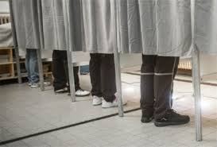
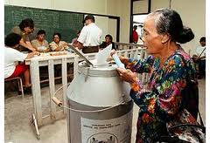

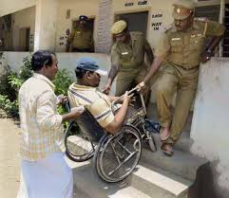
Contenido

Slide 9
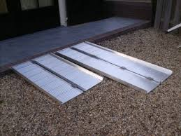
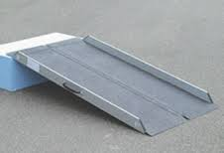
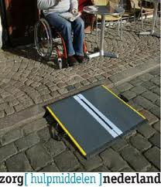
Proposals for improvement at the polling stations

Slide 10


